Slide 1
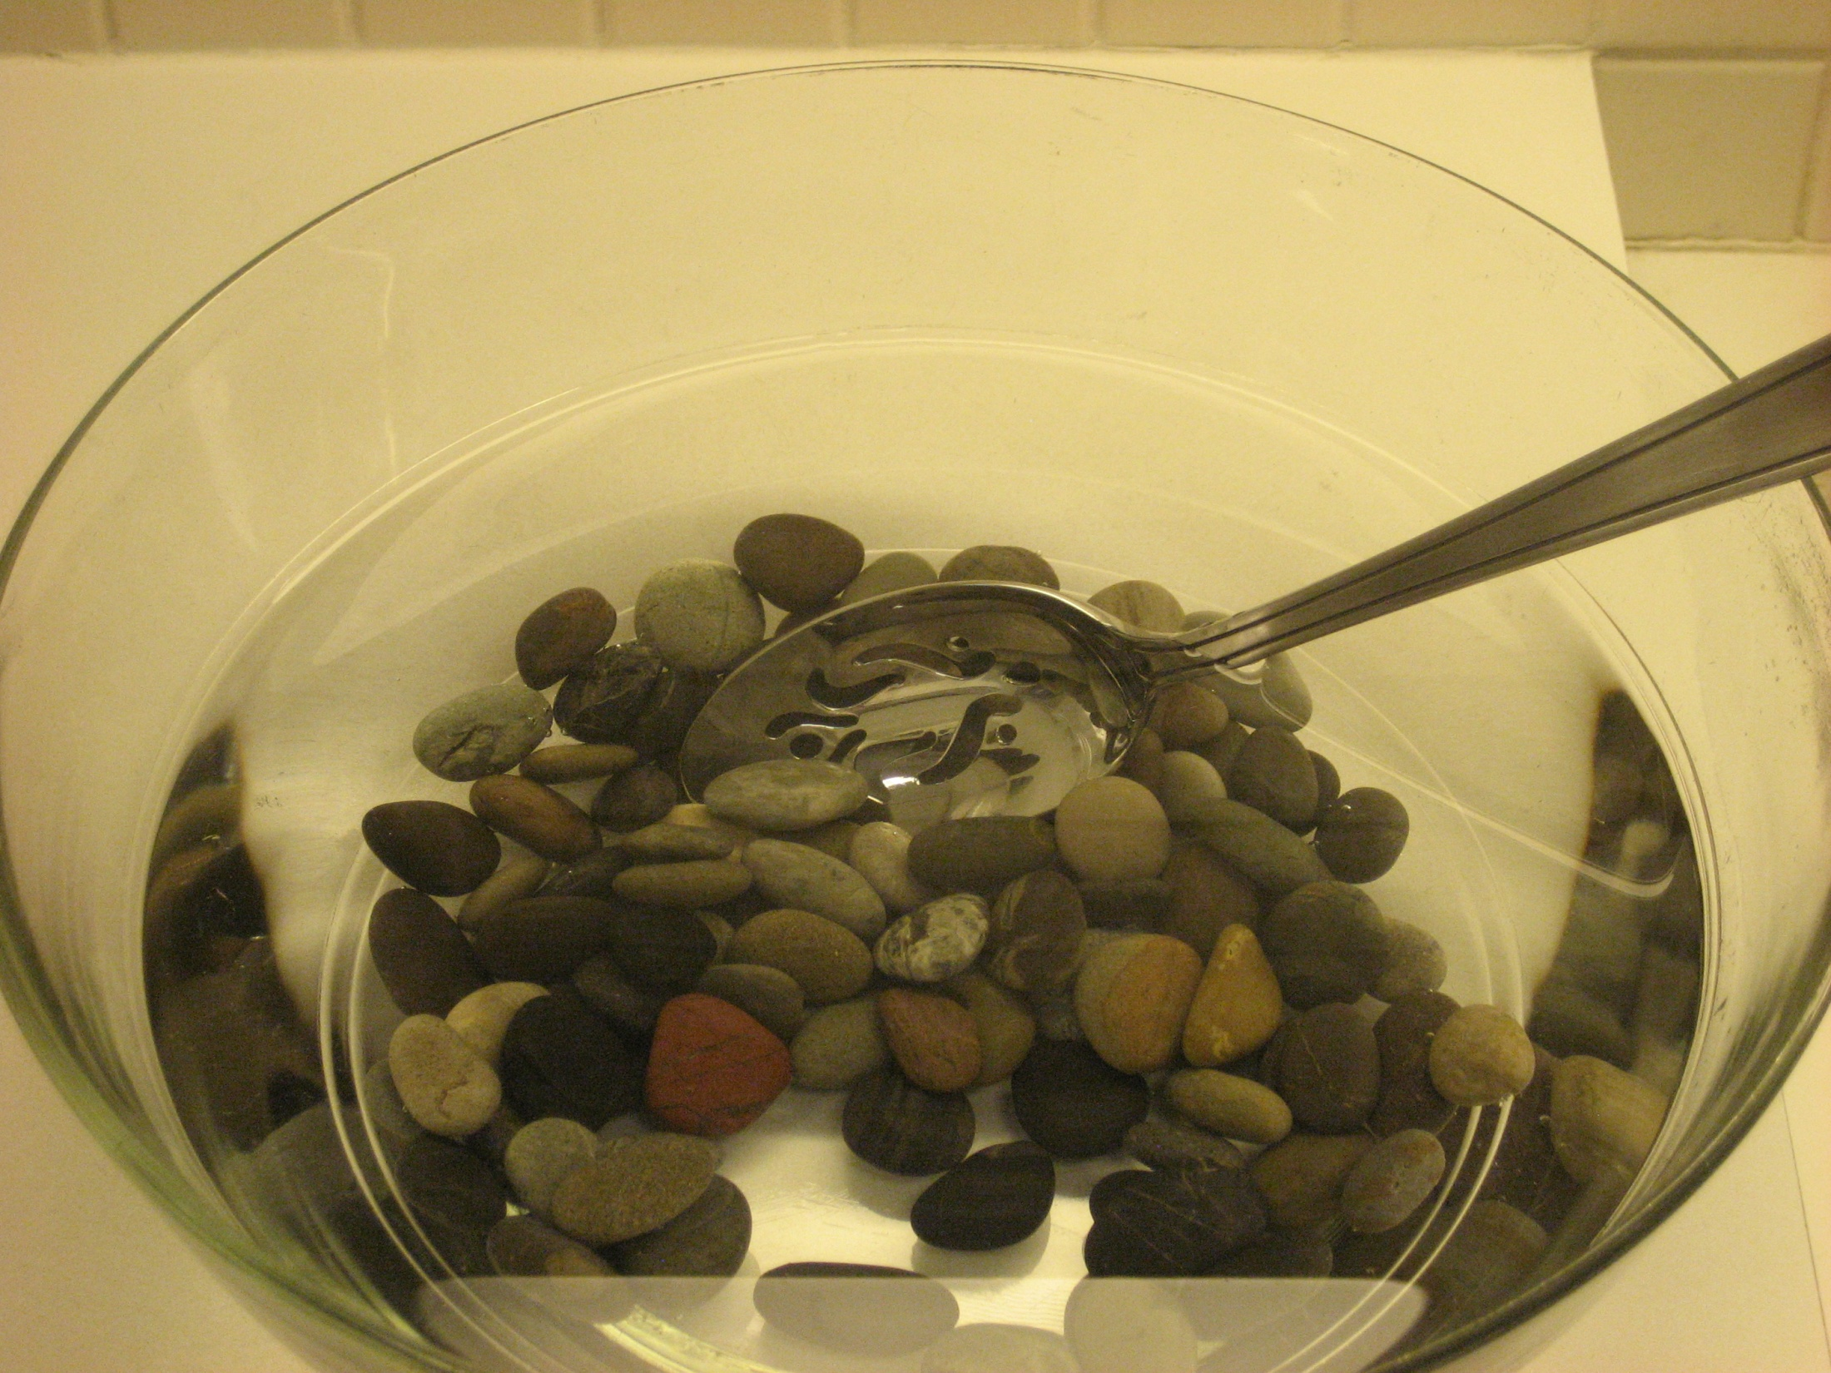
The Health Care Workforce
for an Aging America:
Moving to Action

Slide 2


Retooling: Moving to Action
Christopher A. Langston, Ph.D.
Program Director, The John A. Hartford Foundation Inc.
November 2011
Christopher.Langston@jhartfound.org
(212) 832-7788

Slide 3

“Knowing is not enough; we must apply.
Willing is not enough; we must do.”
—Goethe
INSTITUTE OF MEDICINE OF THE NATIONAL ACADEMIES
Adviser to the Nation to Improve Health

Slide 4


Notable Reports
To Err is Human
Crossing the Quality Chasm
  Lots of follow-up activity, awareness, and even change – but not without lots of work
Front-of-Package Nutrition Rating
Systems and Symbols: Promoting
Healthier Choices?
Notes:
Health Sciences Section publications:
Genes, Behavior, and the Social Environment: Moving Beyond the Nature/Nurture Debate Aug 16,2006
Organ Donation: Opportunities for Action May 02,2006
Sleep Disorders and Sleep Deprivation: An Unmet Public Health Problem Apr 04,2006
Healthcare & Quality publications:
Hospital-Based Emergency Care: At the Breaking Point Jun 14,2006 Emergency Medical Services At the Crossroads Jun 14,2006

Slide 5
Three-Pronged Approach to
Building Capacity
Enhance geriatric competence of general workforce in common problems
Increase recruitment and retention of geriatric specialists and caregivers
Implement innovative models of care
Notes:
Three top level recommendations – all of which are relevant to the issues of the direct care workforce.

Slide 6
Enhancing Competence
Professionals
  Doctors, nurses, social workers, pharmacists, etc.
Direct-Care Workers
  Nurse aides, home health aides, personal and home care aides
Informal Caregivers
  Families and friends
Notes:
Professionals refers to all types of health care professionals: Doctors, nurses, social workers, pharmacists, dentists, and others.
Direct-care workers include nurse aides, home health aides, and personal and home care aides. All of chapter 5 is devoted to this workforce.
Informal caregivers are the friends and families of older adults

Slide 7
Expanding Individual Roles (3.3)
Expand the roles of individuals beyond the traditional scope of practice, such as through job delegation.
Development of an evidence base
Measurement of additional competence
Greater professional recognition and salary
Notes:
And one of the least noticed recommendations, is actually the most radical. Jack Rowe who chaired likes to use the analogy of AIDS in Africa. . .
This includes JOB DELEGATION, whereby tasks are passed from more highly trained individuals to individuals with less specialized training. However, this delegation will require training of the professionals in supervisory skills and training of workers in new skills needed, along with the corresponding compensation. Need to recognize that patients and informal caregivers are important in this delegation of tasks.

Slide 8
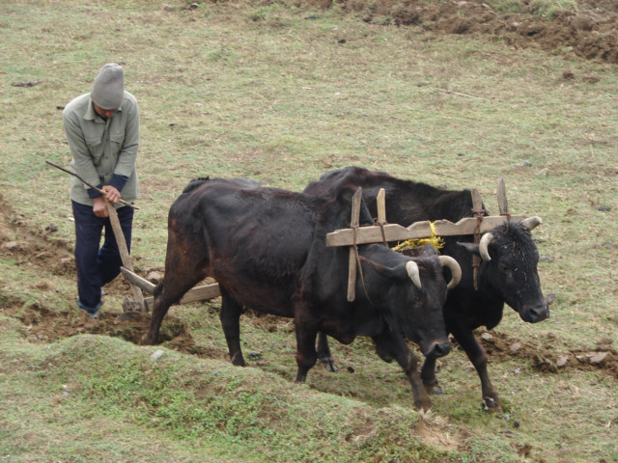
You’ll never plow a field by turning it over in your mind
-Irish Proverb
Notes:
We’re pragmatists by nature.
A lot of people come with good ideas, but we’ve found that often those fall through the cracks unless we quickly move to turn that idea into something tangible
8

Slide 9
An Example
IOM commissioned by congress in 1982 to review conditions in nursing homes
With time, compelling stories, RELENTLESS ADVOCACY, & CONGRESSIONAL CHAMPIONS ->
OBRA 1987 – legislation for restraint reduction, quality reporting, and quality improvement in nursing homes
Notes:
Advancing Quality Improvement Research: Challenges and Opportunities – workshop summary released 5/23/07
Rewarding Provider Performance: Aligning Incentives in Medicare
- released 9/06

Slide 10

Funded by:
The Members
The John A. Hartford Foundation
and
The Atlantic Philanthropies
Notes:
Created through the Tides Center in California capable of handling C3 and C4 monies. C3 from us and C4 from Atlantic as well as member cash contributions and lots of in kind.

Slide 11
Process of Change
Public Policy? Private Policy?
Awareness
Discussion
Consensus
Action
Counter Action
Resolution
Repeat
Funding, Regulation
Self-Regulation, Competencies

Slide 12
Legislative Vehicles
Caring for an Aging America Act of 2008– S2708 (Boxer-Collins)
  Loan forgiveness and incentives for specialists in MD, RN, SW, Psych, CNAs
Geriatric Assessment and Chronic Care Coordination Act of 2007 –S1340/HR2244 (Lincoln)
Geriatricians Loan Forgiveness Act of 2007-HR2502 (Delauro)
Positive Aging Act of 2007 S982/HR1669
None had any chance of
passage in 110th Congress

Slide 13
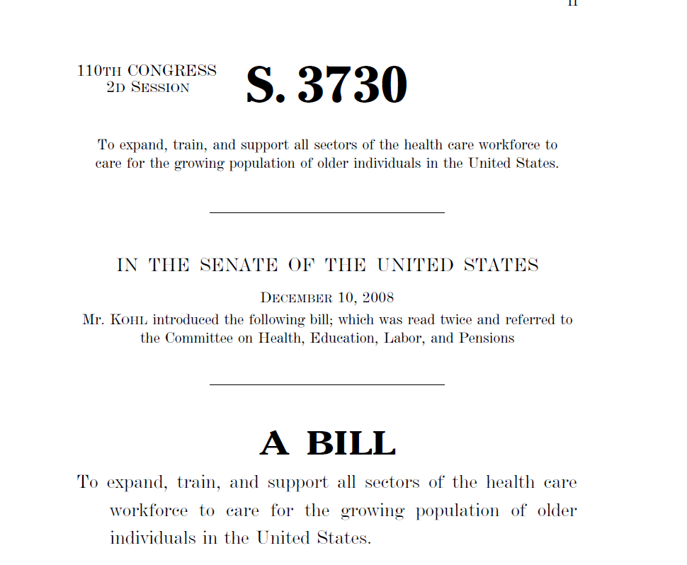
Legislation as Marker
Senator Kohl, Chair, Special Aging Committee – S. 3730
All aspects of
IOM report, barring loan
forgiveness
Still no chance of
passage in 110th Congress

Slide 14
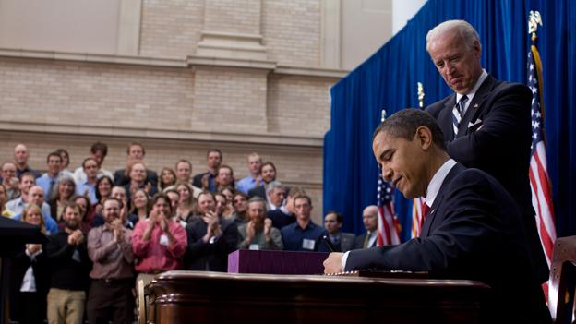
H.R. 3590 signed into Public Law 111-148 March 23, 2010
H. R. 3590
One Hundred Eleventh Congress
of the
United States of America
AT THE SECOND SESSION
Begun and held at the City of Washington on Tuesday, the fifth day of January, two thousand and ten
An Act
Entitled The Patient Protection and Affordable Care Act.
Be it enacted by the Senate and House of Representatives of the United States of America in Congress assembled,
SECTION 1. SHORT TITLE; TABLE OF CONTENTS.
(a) SHORT TITLE.—This Act may be cited as the ‘‘Patient Protection and Affordable Care Act’’.
Notes:
14
* As modified by the Health Care and Education Reconciliation Act (HR 4872)

Slide 15

It’s not about us or our issues

Slide 16
PPACA
Title I – Insurance Regulation, Coverage
Title II – Public programs, Coverage (Medicaid)
Title III – Quality**
Title IV – Prevention
Title V – Workforce**
Title VI – Reporting, Transparency, Fraud
Title VII – Biologics/Medicines
Title VIII – CLASS ACT (long-term Care Insurance)
Title IX – Taxes and Revenue
Title X – Amendments & Additions

Slide 17
Geriatric Specific Workforce
TITLE V—HEALTH CARE WORKFORCE
Geriatric Workforce Development – 24 new Geriatric Education Centers, expanded focus $10.8M, 5 years (Sec. 5305)
Geriatric Career Incentive Awards – non MD awards program (teaching or practice) $10M, 3 years (Sec. 5305)
Training Opportunities for Direct Care Workers – grants program for long-term care workers $10M, 3 years (Sec. 5302)
Healthcare Workforce Center/Analysis/Commission -national and state level look at workforce $39M, 4 years (Secs. 5103, 5101)

Slide 18
Process of Change
Public Policy? Private Policy?
Awareness
Discussion
Consensus
Action
Counter Action
Resolution
Repeat
Funding, Regulation
Self-Regulation, Competencies

Slide 19
Health Professions
Self Regulation
AAMC – “Don’t kill Granny” Medical Student Geriatric Competencies
AGS/ABMS – Convening April 2009
  MOC & CME
CSWE – Geriatric Competencies

Slide 20
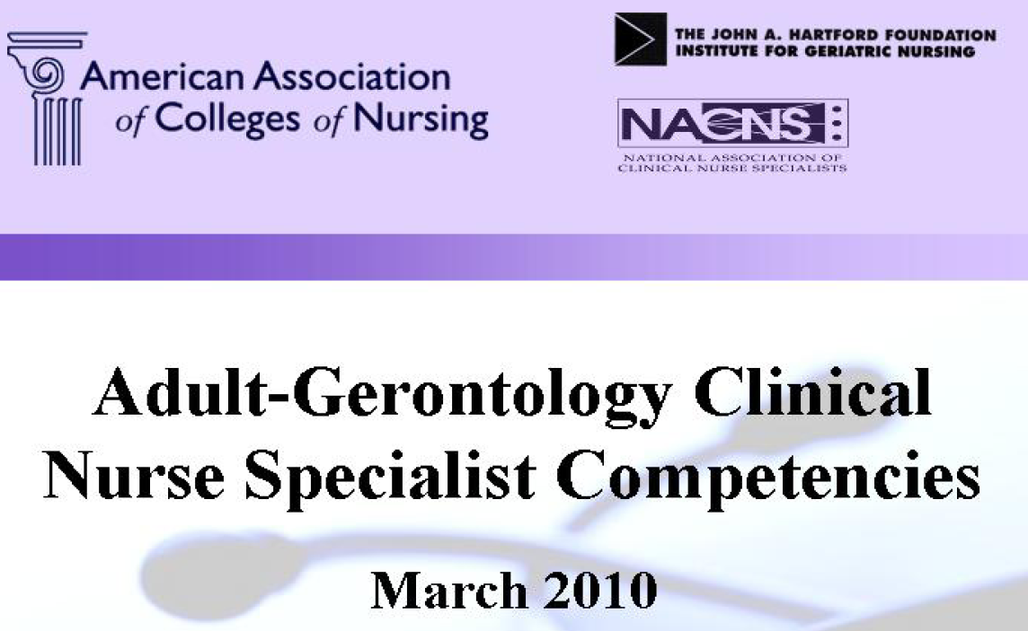
Health Professions
Self Regulation 2008

Slide 21
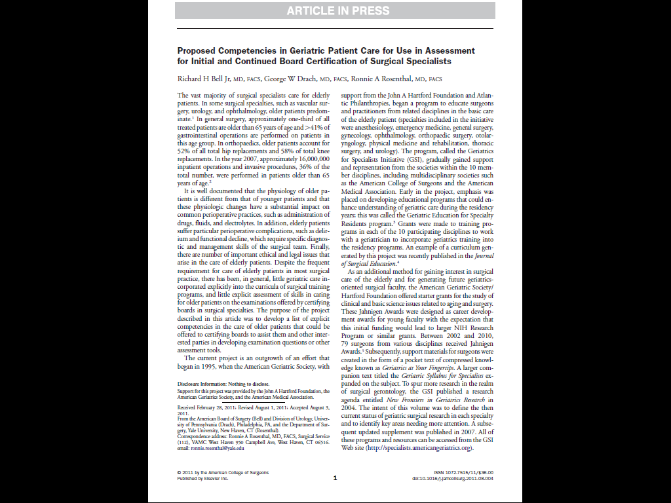
Health Professions
Self Regulation 2011
AAMC – “Don’t kill Granny” Medical Student Geriatric Competencies
AGS/ABMS – Convening April 2009
  MOC & CME
AACN – Geriatric Nursing Competencies
CSWE – Geriatric Competencies

Slide 22

REMEMBER STONE SOUP

Slide 23


Slide 24


