Slide 1

2011 Interdisciplinary Scholars
Communications Conference
WELCOME
The John A. Hartford Foundation
Nora OBrien-Suric, PhD
Senior Program Officer
Notes:
1
Thank you John. As he said, my name is Nora OBrien-Suric and I am a senior program officer at the John A. Hartford Foundation, which every year sponsors this Interdisciplinary Scholars Communications Conference. On behalf of all of our staff and Trustees I want to WARMLY welcome you to this year’s conference, although I should probably say HOTLY and HUMIDLY welcome you, given this summer’s crazy heat. I also want to introduce Jim Gallagher, who works at the Foundation in our Grants Management Department. We’re both very pleased to be here.
First of all, congratulations on your funding from the John A. Hartford Foundation. Most of you are here because you’ve received awards to support your research and to develop your careers in academic geriatrics or gerontology. And some of you work with our grantee organizations that administer the scholarship programs we fund. By being here in whatever your capacity, you have been identified as someone who is dedicated to improving the health of older adults, like we are at the Foundation. And you have demonstrated not only past accomplishments that earned you funding or your position, but also the potential to be leaders in the aging field.
Thank you for taking time to attend this conference, which is focused on improving the way we all talk about our work. This is my third and I can assure you you’ll have a great time and learn a lot. One of the great things is that you get to meet people from other disciplines and other parts of the country. I’ve seen research collaborations form after these conferences, friendships form, I was even proposed to. Well it was actually an exercise and it was John Beilenson on one knee offering his hand, but anyway…it’s a lot of fun and You’ll get practical advice and concrete tools to help you better explain your research and aging issues to a wide variety of audiences – from your Aunt Sally to your US Congress member.

Slide 2
John A. Hartford Foundation: 101
I. Foundation History
II. Foundation Program
III. Communications and Leadership
Notes:
Over the next 10 minutes my job is to give a brief overview of the John A. Hartford Foundation, the 101 course. I’ll start with a little about our history and how we got to our current mission and goal. I’ll then cover our Foundation’s Program and what we do to meet that goal. I’ll wrap it up with a bit about why we are here today and how we see this conference and communications work as supportive of everything we do.

Slide 3
Foundation
Overview
Notes:
So I’ll start with the Foundation Overview.

Slide 4
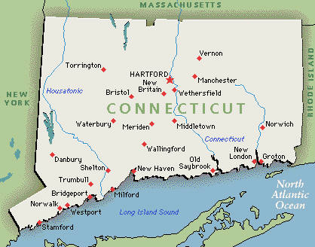

The John A. Hartford Foundation
Notes:
To avoid any confusion, we are not based in Hartford, Connecticut – a lovely place I’m sure, we are in NYC - and we aren’t The Hartford Insurance Group – there are no antlers in our logo and no insurance products to sell.

Slide 5
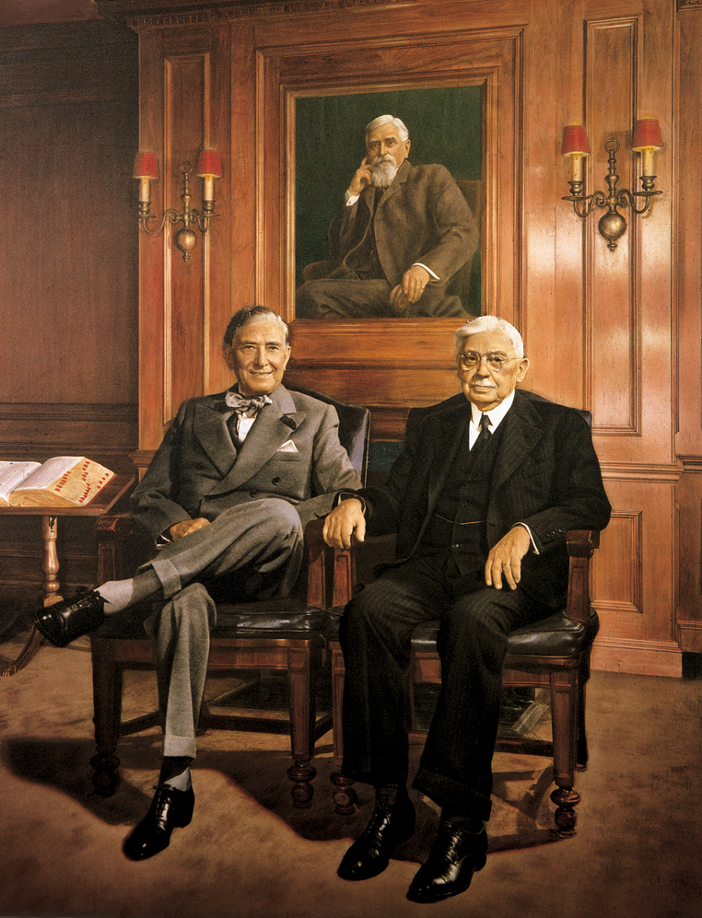
John and George
Notes:
Let me introduce you to John and George. You can also see their father John Huntington Hartford in the portrait behind them.

Slide 6
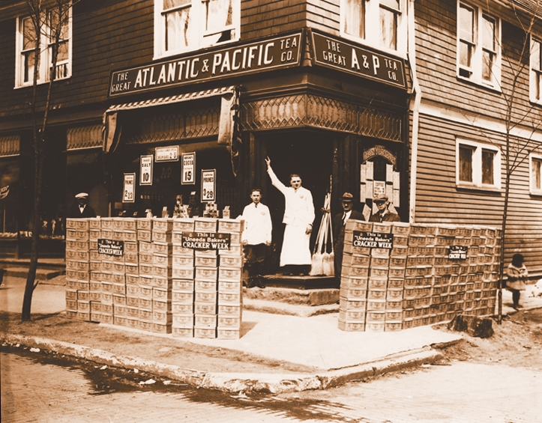
Notes:
The father started and the sons took over the Great Atlantic & Pacific Tea Company, better known as the A&P grocery store empire. According to Time Magazine, in its day the A&P was second only to General Motors in selling the most products in the world.
Through bequests upon their deaths, John and George created the John A. Hartford Foundation in 1929.

Slide 7
“Do the greatest good for the greatest number.”
and…
“carve from the whole vast spectrum of human needs one small band that the heart and mind together tell you is the area in which you can make your best contribution.”
Notes:
John and George left these instructions for future staff and Trustees. Do the greatest good for the greatest number. And carve from the whole vast spectrum of human needs one small band that the heart and mind together tell you is the area in which you can make your best contribution.
The Foundation’s contribution was always health-related - biomedical research in the early years, funding things like the first kidney transplants and early laser eye surgery, before there was anything like the National Institutes of Health.
In the 1980’s the Trustees and staff decided to look more closely at the “one small band” where the Foundation could really do the greatest good. They decided to aim at what they saw as THE big issue that was not being addressed…

Slide 8
Foundation
Program
Notes:
Which leads to our current program and our mission, which is to…

Slide 9
Mission
To improve the health of older adults by
creating a more skilled workforce and a better designed health care system
Notes:
To improve the health of older adults. We are now the leading philanthropy in the US that has this and only this focus.
And we are also very focused in our how we try to meet this goal, which is by creating a more skilled workforce and a better designed health care system.

Slide 10
Why? An Aging America
Over 70 million 65+ by 2030
Older adults = core business of health care
An 80-year old is not a 50-year old: “Don’t Kill Granny”
Fragmented health care system
Notes:
And why? Because as we all well know, we live in an Aging America, with a rapidly expanding older adult population which utilizes the majority of health care. And we know disease presents differently in the elderly, medications can become dangerous. This is why the Foundation supported the American Association of Colleges of Medicine to develop what they called the “Don’t Kill Granny” competencies for all med students – everything they need to know to not harm older adults. And all health professionals need training like this. Older adults are likely to have complex chronic conditions with co-morbidities. And our fragmented health care system is particularly dangerous for them. This all adds up to a great need for a great number of people. And it’s where for the past 30 years the Foundation has developed its expertise and is making its best contribution possible, through the work of grantees and scholars like you.

Slide 11
Through its grant making,
the Foundation seeks to:
Increase recruitment/retention of geriatric specialists in medicine, nursing, & social work;
Improve all health professionals’ ability to deliver skilled geriatric care; and
Redesign models of care that integrate and improve services for older patients.
Academic Geriatrics & Training
Integrating & Improving Services
Notes:
So we are a private charitable foundation. The bequests from John and George created an endowment which is invested, and off of which we are able to make grants to organizations and academic institutions. Through our grant making we try to meet our mission by funding projects that recruit more geriatric specialists, that better educate all health professionals, and that develop and disseminate models of care that create an environment where these better-trained health care workers can practice.
These form our two general funding areas, Academic Geriatrics & Training, focused on the education of health professionals, and the Integrating and Improving Services portfolio of grants, which is focused on the models of care.

Slide 12
Funding Allocation by Portfolio
Notes:
You can see how our funding is generally allocated right now. Our academically oriented programs are where spend most of our money. This is subject to change as we are currently reviewing our strategic plans.

Slide 13
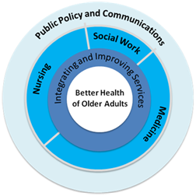
Program Areas
Notes:
This is another way of looking at our theory of change. You’ll notice the category of Other, which I’ll come back to a little later and which supports all of our other work and includes funding for this conference.

Slide 14
Program Strategies
AGT:
Developing aging-expert faculty leaders
  GSA: Geriatric Social Work Faculty Scholars
Curricular change
  AACN: Geriatric Nursing Education Consortium
IIS:
Developing practice change leaders
  STTI: Geriatric Nursing Leadership Academy
Proving and Disseminating models
  U of Wash: IMPACT Depression Treatment
Notes:
In the Academic Geriatrics and Training funding area, there are some common programmatic strategies that we use across medicine, nursing and social work. First, we heavily emphasize the development of aging-expert faculty leaders. They, like many of you, are producing the research and knowledge about aging issues, transmitting that knowledge to students, and by developing strong careers are influencing and transforming education at their institutions for all students. An example of a grant would be our project with the Gerontological Society of America for the Geriatric Social Work Faculty Scholars program, which provides funding over two years to buy out faculty time so they can work on their research and develop their careers.
We also focus on curricular change. The American Association of Colleges of Nursing developed a very successful GNEC program that gives nursing faculty across the country tools and resources to implement curricular changes to their baccalaureate education programs.
In the Services portfolio, we also focus on developing leaders, but in the practice setting, such as with the Geriatric Nursing Leadership Academy run by Sigma Theta Tau International honor society of nursing.
But most of our Services grants are designed to test and then disseminate improved models of health care delivery. One example is the IMPACT Depression Treatment model in primary care clinics which is now being adopted across the country and improving the lives of thousands of seniors who otherwise would receive little or no treatment for depression.

Slide 15





Grantees
Council on Social Work Education
American Academy of
Nursing
Notes:
And here are some of our other grantees. Not shown are all the schools of medicine, nursing, and social work where we have grants, such as our Centers of Excellence in Geriatric Medicine and Centers of Geriatric Nursing Excellence, which are helping to develop geriatrics faculty.
We differ from a lot of foundations in that we do not accept unsolicited proposals. It is a relatively small field, so we identify and work with highly effective organizations and academic institutions to develop the projects that we then fund.

Slide 16
About the Foundation
• Assets of $500 Million
• Annual Payout of $18 - $22 Million
• Over 100 Active Grants
• Median Grant Size: $1.3M over 4 Years
• Average Grantee Tenure 8 Years
Notes:
And here’s a little more about the Foundation. Our asset size makes us a mid-size foundation – no Ford Foundation or Gates, but we have enough to give roughly $20 million each year in grants. We have over 100 active grants, although one organization may have several open grants.
Our endowment does fluctuate with the market, and so the last few years have been tremendously difficult for us. We’ve scaled back our programs and are still in recovery mode. There really is no new grantmaking right now, only the sustaining of our current programs, which brings me to the next point.
What’s unique about our foundation is the depth and duration of our grant making. We invest heavily in projects over many years. Our median grant size is much larger than the average foundation. And most projects are renewed multiple times. This is because we know that change takes time – we are dealing with professions that are largely self-regulated and educational institutions are difficult to change. We have been committed to the field of aging and health for 30 years and will continue to be so for the foreseeable future.

Slide 17







Funding Partners
Donald W.
Reynolds
Foundation
Notes:
But we know we can’t do it alone. We partner with the other major foundations who have substantial interests in aging and health. The two big ones that you should be familiar with are the Atlantic Philanthropies and the Donald W. Reynolds Foundation. Both will be spending down all of their assets over the next ten years, which poses some challenges for us and the field.
Luckily we have other partners across the country. Our staff works hard to develop partnerships and to bring other funders to the table like the Gordon and Betty Moore Foundation on the West Coast which partners on some of our geriatric nursing work, and the Samuels Foundation partners on projects like the IMPACT Depression Treatment model, implementing it locally in New York.
And we try to leverage our funding with the big dollars that can come from the federal government. Our biggest federal partner is the National Institute on Aging, which supports several of our career development awards programs.

Slide 18
Program Areas
Notes:
And now back to that “Public Policy and Communications” program area.

Slide 19
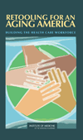
“Other” Grant Making
2008 Institute of Medicine Report, Retooling for an Aging America
Policy & Advocacy: The Eldercare Workforce Alliance
Brooking Institute Convening on Older Adults and ACO’s
Communications & Dissemination Initiative (SCP)
Notes:
In the “public policy and communications” category, we make grants or use our resources to support all of our other work. This is our way of trying to influence the wider environment that we operate in. We know the US health care system is complex and debates are very politicized. There are bad policies, misaligned incentives and fragmentation that makes our work much harder. So we try to address some of these bigger picture issues by, for example commissioning the 2008 Institute of Medicine report, Retooling for an Aging America, which is definitely a must-read. The highly respected, nonpartisan IOM independent study determined that current care is not optimal for older adults, and the report calls for policies to support the recruitment of more geriatric specialists, better training for all health care professionals, and better models of care (sound familiar?). Needless to say we were very glad to hear that we were on the right track.
But a report is just a report. So we help support the Eldercare Workforce Alliance. This is our big policy grant, which supports the alliance of 25 organizations that are advocating for the policy changes called for in the IOM report.
Our staff is also connected to the broader field and we help to convene forward-thinking meetings, such as a recent one held with the Brookings Institute on how to incorporate the needs of older adults into Accountable Care Organizations, which are to be tested with the passage of the Affordable Care Act. Again, trying to insert aging issues into the larger health care debate.
Our longest-term effort to influence the broader environment in which we work is our Hartford Communications and Dissemination initiative, which is what brings us here today. We have been working with Strategic Communications and Planning for over ten years and they are truly leaders in the field of communicating about the importance of aging issues. They provide a number of valuable services…work with the media to promote grantees, help us with our blog, the Health AGEnda.
We’ve recognized that without effectively communicating about our work we can’t be successful. We can have the best model, but if we can’t communicate about it and get it adopted, then we fail. If we can’t communicate the importance of having aging-expert faculty to deans of schools of social work and nursing, then we won’t succeed. A strong communications strategy is essential for us to reach our goals. And this brings us to my conclusion and why we’re here today.

Slide 20

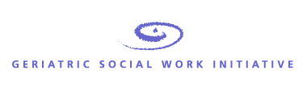

Communications & Dissemination Initiative
Notes:
To reach our goals, we realized that effectively communicating about our work is critical.
SCP gives consults with many of the leaders and staff of our grant projects, as well as helping to coordinate the communications activities for the collective group of grantees in our overall nursing and social work initiatives. SCP reach out to the media, help us with our staff blog, the Health AGEnda, and provide support for the entire Hartford network, including scholars and fellows like of you, with free resources like Bandwidthonline.org.
And of course, as part of the Communications Initiative, SCP organizes this conference for scholars and project leaders like you. We want all of our Hartford network to feel comfortable and be expert not only in their area of research or work, but also in communicating about it.

Slide 21
Communications and Leadership
Notes:
Which is that we believe that effective communications is not only critical for us at the Foundation level, but also for all of our grantees and our entire network of scholars and fellows who are working on aging and health issues. Our success is built on your success, which is built on you being an effective communicator about your work and the issues you care about.

Slide 22
Communicate to…
Garner support and funding for your work
Raise awareness about the issues and get others involved
Influence your system to improve health care practice or education
Convince your political leaders to make better policies
…lead change that will improve the health of older adults.
Notes:
We want all of our network to be better able to communicate with their peers in other disciplines – both those who are and aren’t focused on aging issues – as well as institutional leaders, other funders, policy makers, and the public.
We we want you to be better communicators benefit your career, raise awareness about the issues you work on, influence your institutional environment, and even change the hearts and minds of our political leaders.
What we really want is for you and all of us to be able to communicate to lead change. Lead change that will And creating change is really what being a leader is all about. And in many ways, that’s what we are really investing in at the Foundation.

Slide 23
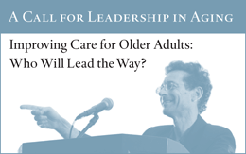
We believe YOU will lead the way…
Hartford Foundation 2008 Annual Report
Notes:
In 2008, we recognized that importance of leadership development as an underlying program strategy and we dedicated our annual report to how our grantees and projects develop leaders across all of our funding areas.
We included in that report a call or challenge, asking Who will lead the way in improving care for older adults?
We believe that you and others funded through John A. Hartford Foundation programs will be those leaders and we want to do everything we can to support you in your work. We want to help you be a better communicator and a leader of change for the sake of our parents, grandparents, and ourselves as we all age.
I’d like to close by thanking John, Chris and SCP for putting this conference together. I know it’s a ton of work. And I once again offer my congratulations to all of the participants. I encourage you to actively participate, ask a lot of questions, reach across interdisciplinary boundaries and to talk to Jim or I if you have any questions about John and George and the Foundation.

Slide 24
Thank You and Enjoy the Conference
www.jhartfound.org

