Slide 1
Perspective from the Epicenter: Serious illness & end-of-life care
Amy Berman, BS, RN

Slide 2
Objectives
Define patient-centered care
Identify three things you can do to ensure patient-centered care.
Define the difference between palliative care and hospice
Notes:
1. Be able to define patient-centered care
2. Identify three things you can do to ensure you provide and receive patient-centered care.
3. Be able to define the difference between palliative care and hospice

Slide 3
Notes:
First let me introduce you to The Hartford Foundation. We are the largest Foundation focused solely on improving the health and healthcare of older adults. That is John A. Hartford on the left and his brother George on the right.

Slide 4
Notes:
You may remember the A & P food store chain. John and his brother George were former CEOs of A&P food store chain. The Foundation was founded in 1929 and when they died in the 1950s the bulk of their estates went to the Hartford Foundation.
Early on the Hartford Foundation was focused on biomedical discovery. We funded the development of the ICU, dialysis, kidney transplantation, the artificial heart, and much more. Before the NIH was established, we were the largest funder of biomedical innovation. In the 1980s our mission changed.

Slide 5
Hartford Foundation Mission
Increase the nation’s capacity to provide effective and affordable care to its rapidly increasing older population
Notes:
Today we are the largest foundation focused solely on improving health and healthcare of older adults. There are two main strategies we use: 1) improve the competence of healthcare providers caring for older adults, and 2) develop effective and affordable models of care to support the health of older adults.

Slide 6
Changing Demographics
%
%
%
Notes:
It’s important to note that the older population is rapidly rising. Serious illness and end-of-life care issues more common within this demographic.
Here’s a quick snapshot of the aging population.
Here on the left you will see that today only three states in dark blue have 15% or more of their population ages 65 and over. On the right, in less than 15 years from now, most of our nation will look like Florida or worse, with corresponding demands across the health care system.

Slide 7
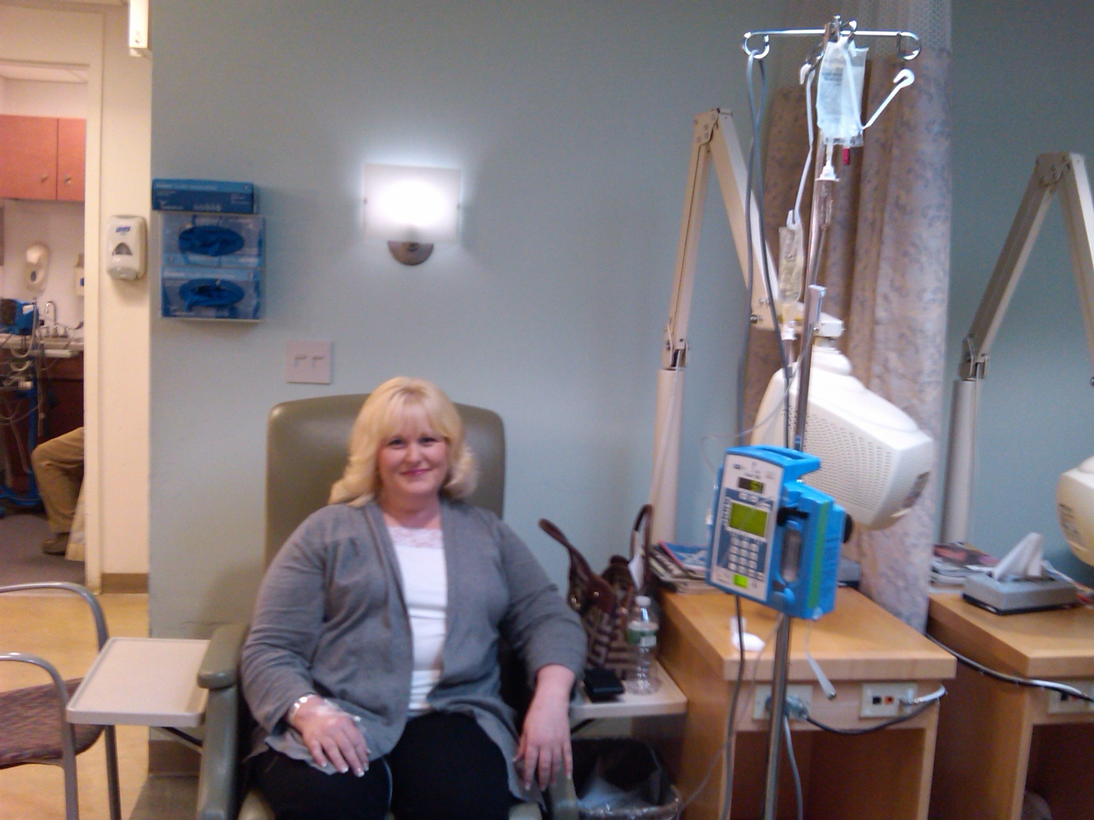
Notes:
In the interest of full disclosure, I am a nurse but I am also a person experiencing serious illness.
[background on my terminal diagnosis]

Slide 8
Patient-Centered Care
“Care that is truly patient-centered considers patients’ cultural traditions, their personal preferences and values, their family situations, and their lifestyles. It makes the patient and their loved ones an integral part of the care team who collaborate with health care professionals in making clinical decisions.”
-- Institute for Healthcare Improvement
Notes:
We all assume that when we or our families are ill that they will receive the care that they want. We also assume that we provide patient-centered care.
There are three important pieces to patient-centered care:
1. Involving patients and families in the design of care
2. Reliably meeting patient’s needs and preferences
3. Informed shared decision-making

Slide 9
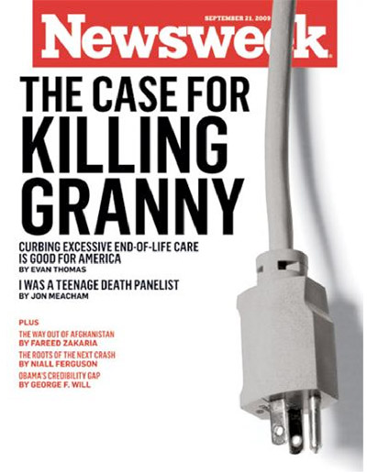
Notes:
Patient-centered care relies on patient and family input. Recently just the mention of conversations at the end-of-life have spurred charged language like “death panels” and “rationing” that prevent patient input into their own treatment decisions.

Slide 10
How can care be Patient-Centered when we don’t discuss serious illness with the patient?
Notes:
Medicare was going to cover “voluntary advance care planning,” to discuss end-of-life treatment, as part of the annual physical examination. Because of the charged rhetoric the discussion is no longer considered part of the annual Medicare physician visit.
What is advanced care planning and why is it important?
Advanced care planning provides a range of options and helps to clarify the patient’s goals and values. When someone is diagnosed with terminal illness they may want aggressive treatment even when they are dying. Some want care that focuses on maintaining the quality of their life. Before deciding what is best it’s important to understand the benefits and burdens associated with these decisions.
The goals of care should always be the patient’s. Decisions related to serious illness impact the length of life and the quality of life. In order to make good decisions you need to know your condition and the likely course of events, also known as your prognosis. And you need to know what the treatment options are, the risks, how will it make you feel, and will it likely offer any health benefit.
Some would suggest that you should be aggressive until the end. That choice would meet some people’s values and goals. However I want you to fully understand what is at risk. Allow me to use my own experience as an illustration.

Slide 11
Notes:
It was just another day in NYC.
[Story on how I was dx’ed and made treatment decisions—illustrate how these decisions need to be weighed carefully. I did not choose aggressive treatment.]

Slide 12
Three Things You Can Do
Ask about your care options
Make your values and goals understood
Complete advance directives and make sure your healthcare providers and family have them to ensure your choices are honored
Notes:
As an expert consumer I received patient-centered care because I knew what questions to ask and how to advocate for myself. Here are three things you can do to ensure that you, your family and your patients receive patient-centered care:
+ Ask about your care options
+ Make your values and goals understood
+ Complete advance directives and make sure your healthcare providers and family have them to ensure your choices are honored
Let’s quickly review Advance Directives.

Slide 13
Basic Advance Directives
Do Not Resuscitate Order (DNR)
Health Care Proxy
Living Will
Notes:
More than 75% of people will be unable to make some or all of their own medical decisions at the end of life.
Planning ahead for end-of-life care is meant to allow patients to reduce the amount of medical intervention, if that's what they prefer. But patients also can make clear their wishes if they prefer maximum intervention.
Planning ahead can reduce the burden of making these decisions on the families at a time of great stress.
If you document it and share it with the healthcare team, you can get the care you want.
[will explain terms and where to find the forms]
+ DNR: Resuscitation, also known as CPR, attempts to restart breathing and the heartbeat of a person who has no heartbeat or has stopped breathing. It typically involves “mouth to mouth” breathing and forceful pressure on the chest to try to restart the heart. DNR lets the health team know that you do not wish to be resuscitated.
+ Health Care Proxy: designate someone to make decisions for you when you are unable
+ Living Will:A living will is a legal document that a person uses to make known his or her wishes regarding life prolonging medical treatments. One example is the POLST.

Slide 14
POLST
Physician Orders for Life Sustaining Treatment (POLST)
Medical order that indicates the treatment you want in the last stages of illness
www.coalitionccc.org
Notes:
(Physician Orders for Life-Sustaining Treatment) POLST form is important for people with serious health conditions. It is used to make a person’s wishes for medical care known to doctors, nurses, emergency medical personnel and other healthcare staff. The POLST form is a bright pink medical order form. Your doctor uses the POLST form to write orders that indicate the treatment you want in the last stages of an illness.
Studies show that many elderly patients prefer to limit medical interventions. In one study of hospice patients, 79% wanted comfort measures only, and 20% wanted only limited additional interventions such as intravenous fluids and antibiotics. This form let’s a seriously ill person document in great detail what care they want and don’t want including resuscitation, comfort measures and even antibiotics.

Slide 15
Palliative Care
Palliative care focuses on improving the quality of life of people facing serious illness. Emphasis is placed on pain and symptom management, communication and coordinated care. Palliative care is appropriate from the time of diagnosis and can be provided along with curative treatment.
www.getpalliativecare.org
Notes:
NEJM article lung cancer pts lived longer when palliative initiated at start of illness.

Slide 16
Hospice
Provides comfort & support to patients and their families when a life-limiting illness no longer responds to cure-oriented treatments.
Neither prolongs life nor hastens death
Improves quality of a patient's last days by offering comfort and dignity.
www.hospicefoundation.org

Slide 17
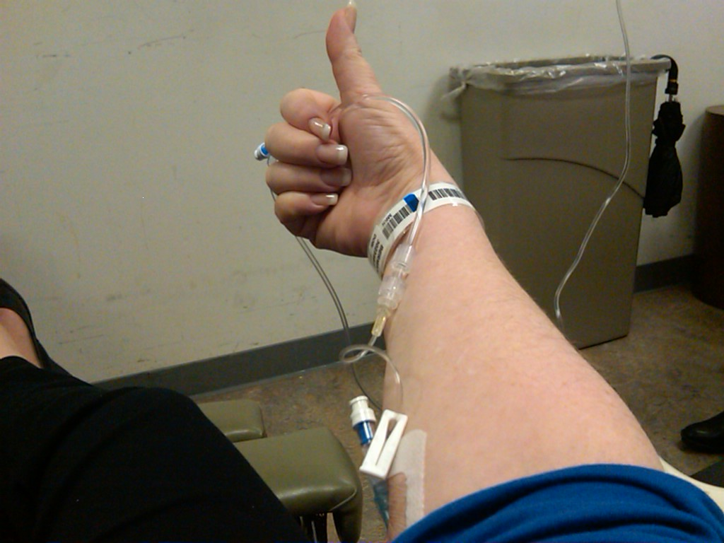
Special Thanks
American Federation of Teachers Healthcare Division
Notes:
Summary and charge– to support the kind of care you, your family, and your patients want at the end-of-life.
Health care system is set up to treat and cure.

