Slide 1
Re-Forming Health Care: Sustainable Systems for Healthy Aging
Nancy Whitelaw, PhD
National Council on Aging
November 2010

Slide 2
Evidence-based Change!
Credit to:
Administration on Aging
Centers for Disease Control and Prevention
AHRQ , NIH, SAMHSA and other federal agencies
John A. Hartford Foundation
Atlantic Philanthropies
Retirement Research Foundation
Archstone Foundation
Regional Foundations
States and Localities

Slide 3
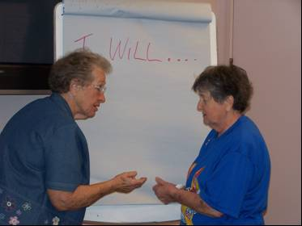
Healthy Aging …More than a program
Healthy aging is a systems change strategy, not simply a program or service.

Slide 4
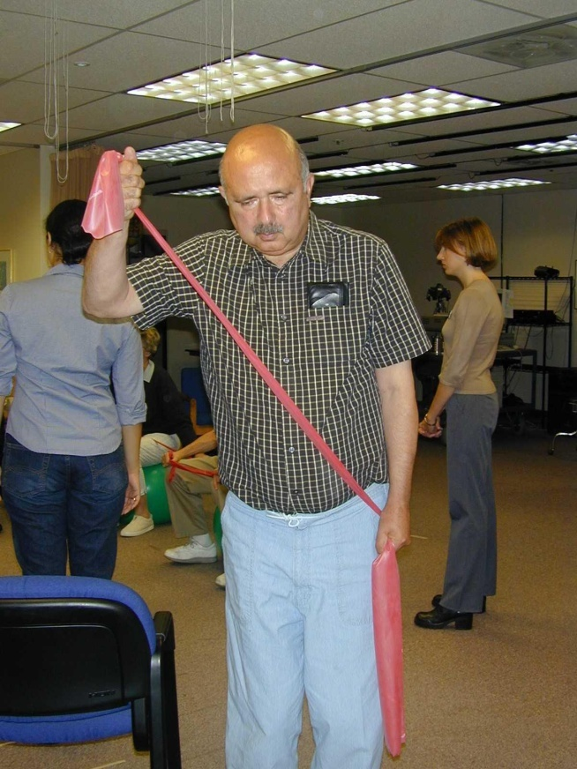
Principles for Healthy Aging
Prevention
Self-management &
self-determination
Evidence and outcomes
Community-based &
collaborative solutions
Challenge ageism & health disparities

Slide 5
Healthy Aging Systems Model
Policy
Multisector Collaboration
Research
Organizational Networks
Evidence-based Programs

Slide 6
Multi-sector Collaboration
Public, Private, National, Regional, Local
Aging
Public health
Mental health
Long-term care
Health care
Housing
Education
Employment
Academe
Philanthropy

Slide 7
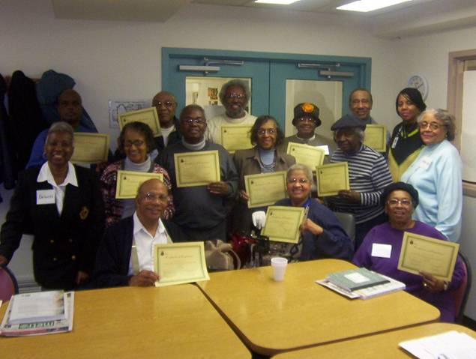
An Evidence-based Approach
Evidence of a Problem
Evidence of Programs with Results
Evidence about Embedding and Sustaining

Slide 8
Evidence of a Problem
Medical Expenditure Panel Survey (MEPS) -- AHRQ
Medicare Standard Analytic File
Actual Causes of Death, McGinnis and others begun in 1993
The State of Aging and Health in America
Healthy Aging in Oregon Counties
Blueprint for Healthy Aging in New Jersey
Healthier Lives: Americans Speak Out About Chronic Conditions & the Pursuit of Healthier Lives
Gaps in the System: Californians Struggle with Caring for Their Chronic Conditions

Slide 9
Evidence of Interventions That Work
CHRONIC DISEASE SELF-MANAGEMENT PROGRAM Lorig, KR et al. (1999) Medical Care.
ENHANCE FITNESS: Wallace, JI et al. (1998) Journal of Gerontology.
ENHANCE WELLNESS: Leveille et al. (1998) Journal of American Geriatrics Society
MATTER OF BALANCE: Tennsdedt, S et al. (1998) Journal of Gerontology.
PEARLS: Ciechanowski, P et al. (2004) Journal of the American Medical Association.
Healthy IDEAS: Quijano, L et al. (2007) Journal of Applied Gerontology
And others ….
Notes:
Group and individual
Home and agency settings
Professional and lay interventionists

Slide 10
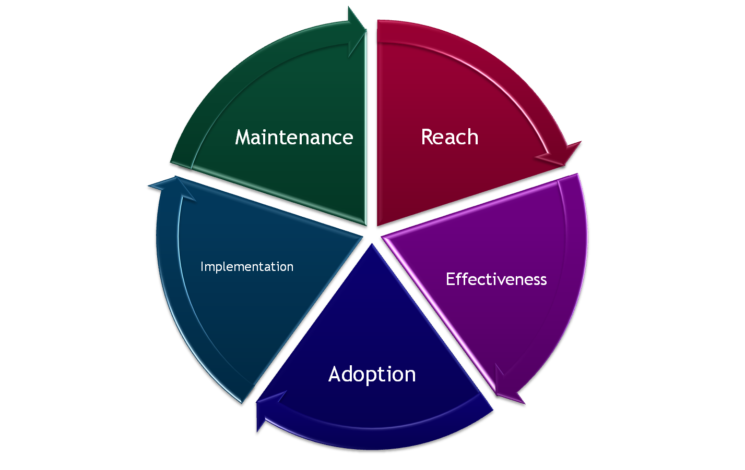
Evidence of Embedding and Sustaining
(P)RE-AIM Framework www.re-aim.org
Planning and
Partnerships
Notes:
The RE-AIM framework provides public health and community settings a systematic way to approach health behavior promotion planning, design, and evaluation.
Reach the target population
Efficacy or effectiveness
Adoption by target settings or institutions
Implementation - consistency of delivery of intervention
Maintenance of intervention effects in individuals and populations over time

Slide 11
Program Reach
14 Programs reaching 59,131 elders in 24 states into 4th year
Chronic Disease Self-Management Program reaching 42,015 elders now in 46 states
Year | Participants
1 | 6,840
2 | 18,717
3 | 25,211
Year | Participants
1 | 3,630
2 | 9,229
3 | 11,262
4 | 17,894

Slide 12
Participant Characteristics, 3+ Years, N = 59,131
Characteristic | Percent
Age 75+ | 53%
Gender Female | 79%
Living Alone | 50%
Racial/Ethnic Minority Group | 33%

Slide 13
Program Adoption Over 9 Years
Years of Growth
2001 | 4 communities
2003 | 14 communities
2006 | 16 states
2007 | 27 states
2010 | 46 states
Adoption in 4 years
Organization Type | 700 Lead Orgs | 3700 Sites
Aging network; senior housing | 40% | 58%
Social services, faith-based | 15% | 25%
Public health, recreation | 20% | 3%
Health care | 25% | 14%

Slide 14
Participation Levels & Fidelity
Program | Measure | Achievement
Chronic Disease Self-Management | 4/6 classes | 76%
Matter of Balance | 5/8 classes | 79%
Enhance Fitness | Average Monthly Attendance | 60-65%
Fidelity Monitoring – Hawaii Example
10 item Tool
Average Score for 736 assessments: 3.7 out of 4

Slide 15
Preliminary Program Effectiveness for CDSMP
2006-2007 states choosing to conduct evaluation
Pre-post self report surveys (6 months post)
Within state analyses indicate:
Reductions in pain and fatigue
Improvements in physical activity
Improvements in confidence, efficacy for self-management
Improved communication with physician
Reductions in health care utilization

Slide 16
Wisconsin
The Model: Wisconsin Institute for Healthy Aging will promote, coordinate, implement, monitor and assure quality in evidence-based prevention programs in Wisconsin.
Founding Partners
University of Wisconsin School of Medicine and Public Health
State of Wisconsin Department of Health Services
Aging and Disability Professional Association of Wisconsin
Aurora Health Care
Greater Wisconsin Agency on Aging Resources
Goal: Sustainable, independently governed organization with diverse funding mechanisms

Slide 17
New Jersey
The Model: Integrate CDSMP and other evidence-based programs into the primary networks serving older adults and persons with chronic conditions throughout the state.
Lead Organizations
Division of Aging and Community Services
Office of Minority and Multicultural Health
Division of Family Health Services
Financing
Older Americans Act
CDC and Preventive Health Block Grant
State funds
Rural Health

Slide 18
Healthy Aging Regional Collaborative
The Model: Health Foundation of South Florida supports and coordinates collaboration among multiple levels of society and diverse groups, including the public, health care providers, government agencies and community groups.
Network contagion improves reach and quality
Key Features
Multi risk factor, multi program strategy with commitment to access and addressing disparities
Leadership Council – national, state and local
Strong multi-faceted evaluation
Building toward diverse sources of long-term financing

Slide 19
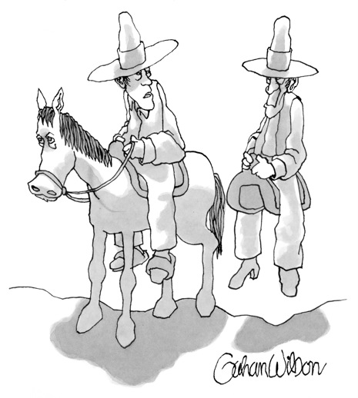
Thank You
Nancy Whitelaw, PhD
Nancy.whitelaw@ncoa.org
“You always have to be an early adopter.”
Caption by Richard Gage
for New Yorker Cartoon

